Slide 1
Wi-Fi Password Cracking
Semester Project

Slide 2
Table of contents
01
02
03
04
05
06
Abstract
Introduction
Tools Used
Procedure
Mitigation
Conclusion

Slide 3
01
Abstract

Slide 4
Wi-Fi cracking seeks unauthorized access by exploiting network vulnerabilities, often for assessment or malicious purposes. Ethical hacking, or penetration testing, provides a legal means to assess network security with owner consent, emphasizing adherence to ethical and legal guidelines to avoid serious consequences.

Slide 5
2
Introduction

Slide 6
Aircrack-ng, a powerful suite for ethical hacking and penetration testing, excels in Wi-Fi vulnerability assessment. Security professionals leverage its features for monitoring, capturing network traffic, and robustly securing wireless networks. It is a must-have tool for cybersecurity practitioners.

Slide 7
3
Tools Used

Slide 8

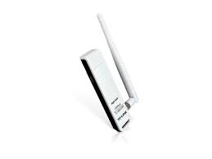
Kali Linux
TP-Link TL-WN722N

Slide 9
4
Procedure

Slide 10
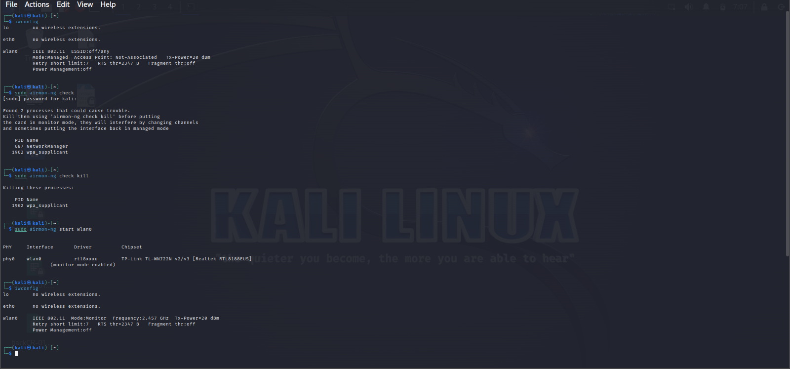
Enabling Monitor Mode

Slide 13

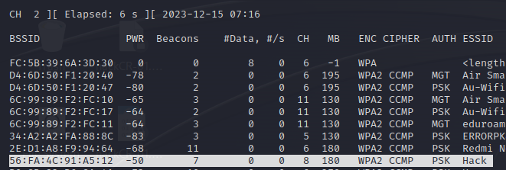
Capturing Handshake

Slide 14
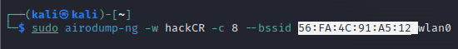
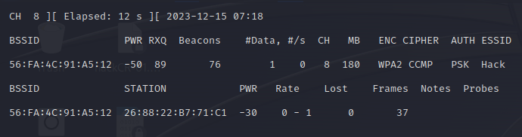

Slide 15
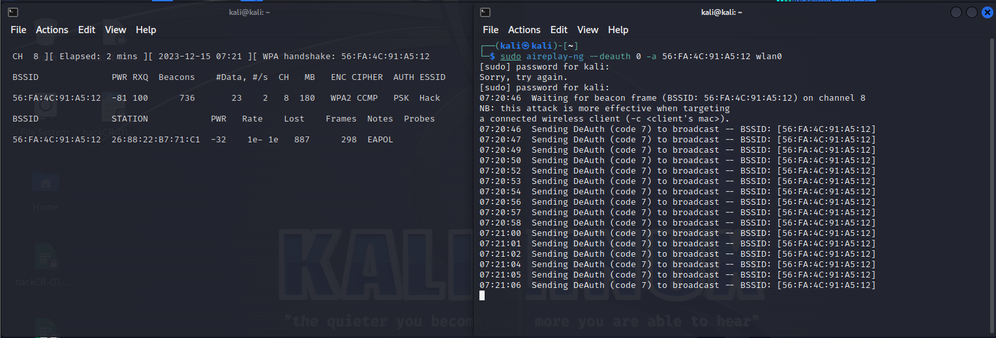

Slide 16
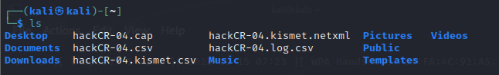

Slide 17
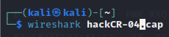
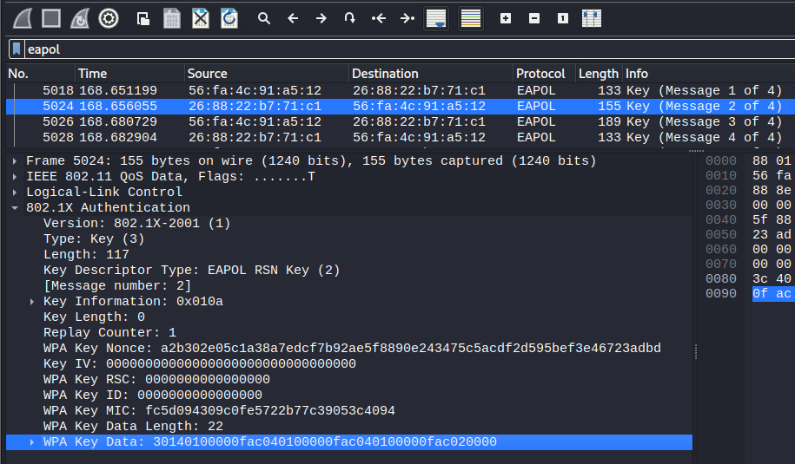
Cracking Password

Slide 18

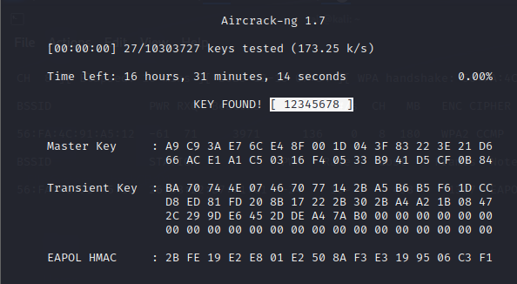

Slide 19
5
Mitigation

Slide 20
Ensure your network's safety. Set strong passwords, activate WPA3 encryption, and regularly update your router. Periodically check your network's security to maintain a robust defense against potential threats.

Slide 21
6
Conclusion

Slide 22
'Aircrack-ng' demonstrates ethical hacking's efficacy in Wi-Fi vulnerability assessment. Meticulous execution underscores robust security practices. It's a vital tool for cybersecurity, ensuring a safer digital landscape.

Slide 23
ANY QUESTIONS?

Slide 24
THANK YOU
DANIYAL Aftab MIRZA

